Slide 1
Lecture 15 LPWAN Wrap-up and RFID
CS397/497 – Wireless Protocols for IoT
Branden Ghena – Winter 2021
Some slides borrowed from Ambuj Varshney Uppsala / UC Berkeley

Slide 2
Today’s Goals
Discuss challenges faced by LPWANs and possible solutions
Describe RFID communication and backscatter
Explore how backscatter techniques can be used for sensor networks

Slide 3
Outline
LPWAN Challenges
Bit flux
Capacity problems
Coexistence problems
RFID Overview
Backscatter for Sensors

Slide 4
Do novel networks meet application needs?
How do we compare varied requirements and capabilities?
Networks have throughput per gateway and range of gateway.
Applications have throughput per device and deployment area.
Each gateway must support throughput for all devices in its coverage area.
Deployment areas are often wider than a single gateway’s range.
Solution: compare the density of communication.
Data communication rate per unit area.

Slide 5
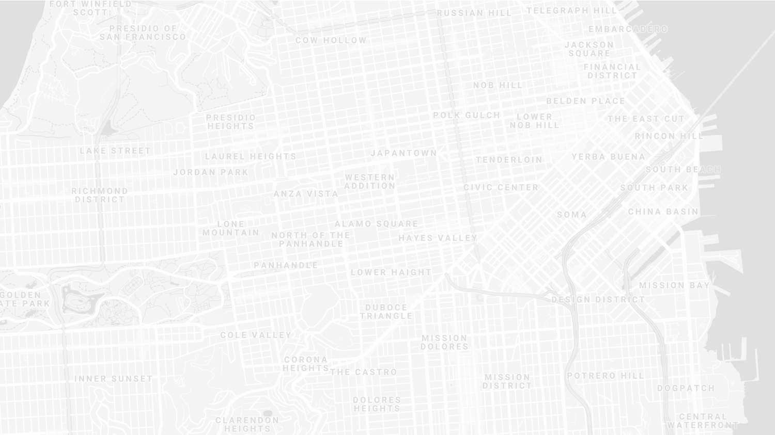
New metric for wide-area communication.
Our proposed metric: bit flux
$bit flux= \frac{network throughput}{coverage area}$
Units: bit per hour / m²
First suggested by Mark Weiser
Branden Ghena, et al. "Challenge: Unlicensed LPWANs Are Not Yet the Path to Ubiquitous Connectivity." MobiCom’19
Notes:
bit flux is our metric for data density
throughput divided by coverage area
As with many ideas, this was first suggested by Mark Weiser

Slide 6
Bit flux can measure application needs.
For an application:
$$bit flux= \frac{\sum{each device^{′}s uplink}}{deployment area}$$
Assumes a relatively homogeneous distribution.
Notes:
For applications, bit flux sums the data needs for each device in the deployment
And divides by the total deployment area
To determine the application uplink density

Slide 7
Bit flux can measure network capabilities.
For a network:
$$bit flux= \frac{gateway goodput}{gateway coverage area}$$
Assumes a non-overlapping deployment of gateways.
Note that bit flux alone ignores the total number of gateways required.
Notes:
For networks, we divide the goodput of a network
By the coverage area of a single gateway
This gives us a number that represents the data density that a network can support, at any width of deployment

Slide 8
Bit flux accounts for spatial reuse.
Reducing coverage area and deploying additional gateways improves capacity.
$bit flux↑ = \frac{gateway goodput}{coverage area↓}$
Notes:
Bit flux also accounts for spatial reuse in networks
Reducing range (and deploying more gateways), reduces the coverage area for each gateway, increasing the network bit flux

Slide 9
Bit flux measurement for LoRaWAN.
ALOHA access control
$$\frac{5\frac{kbps}{channel} ∗64 channels ∗18\%}{π∗(5 km)2} \text{≈} \frac{58000 bps}{79 km2} \text{≈} 2.6\frac{bph}{m2}$$
Hata model
Notes:
Here is the bit flux measurement for a LoRaWAN network
In the US, LoRaWAN has 64 channels for uplink
But it relies on an ALOHA access control mechanism, so packet collisions reduce throughput significantly

Slide 10
Networks differ in capability by orders of magnitude.
Notes:
We can calculate bit flux for each of the networks we’re interested in
We note that there are several orders of magnitude difference in the throughput capability of each network
Particularly between cellular communication and unlicensed LPWANs

Slide 11
Range reduction results in a bit flux curve for each network.
Notes:
These points are at the maximum range for each network, but they have the ability to perform power control and reduce range
This creates a curve for each network, where we can reduce range (and install more gateways) in order to increase network capability

Slide 12
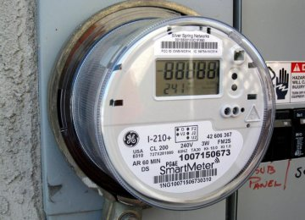
Let’s compare network capabilities to a real-world application.
Smart household electric meters.
~250 bytes of data every 4 hours
~370000 electric customers in San Francisco
$$\frac{\frac{250 bytes}{4 hours} ∗370000 devices}{120 km2} \text{≈} \frac{51000 bps}{120 km2} \text{≈} 1.5\frac{bph}{m2}$$
Notes:
Now that we can measure the capability of each network, lets compare that to the needs of an application
The example I’ll be talking through is Electricity Metering, there are about a dozen others in the paper
PG&E smart meters send about 250 bytes every 4 hours
This isn’t a lot of data, but smart meters are densely deployed, with three hundred thousand across San Francisco

Slide 13
All networks are capable of meeting the data needs of electricity metering.
Electricity Metering Application
Notes:
We can plot the need of the Electricity Metering application as a line on our bit flux figure
Any network above this line is capable of serving the application’s needs
Sigfox needs range reduction, but all networks are capable of serving this application’s needs
So, great! Networks can serve ubiquitous applications. Problem solved, right?

Slide 14
Unlicensed LPWANs lag behind Cellular IoT in ability to support applications.
2G < 0.03% utilized
Notes:
Let’s visualize this instead as the number of gateways deployed and the proportion of network utilized.
Again, because of power control, there is a tradeoff here. We could deploy a single gateway for everything, or many gateways with reduced range to increase capacity.
Cellular networks have no problem with this application
With a single gateway, LTE-M could spend 1% of its capacity to service this app.
Unlicensed LPWANs, however, have choices to make on how many gateways they deploy and how much capacity they are willing to spend on this one application

Slide 15
Sigfox requires range reduction to meet application needs.
Capacity Problem
Throughput capability of Sigfox is insufficient to support application needs
It can only support the application with reduced range and additional gateways
Notes:
There are two particular problems we can see with the unlicensed LPWANs
The first is a capacity issue:
Sigfox can’t satisfy the application at all without power control.
Range is sufficient for a single gateway to cover the city, but it wouldn’t be able to keep up with the data.

Slide 16
Capacity solutions are relatively straightforward.
Better access control mechanisms (OFDMA?).
Recover simultaneous transmissions (Choir and Charm).
Increase bandwidth (TV white spaces).
All likely come at the cost of increased energy usage…
Results in a protocol that looks pretty similar to cellular…
Adwait Dongare, et al. "Charm: exploiting geographical diversity through coherent combining in low-power wide-area networks.“ IPSN’18
Rashad Eletreby, et al. "Empowering low-power wide area networks in urban settings." SIGCOMM’17
Abusayeed Saifullah, et al. "SNOW: Sensor network over white spaces." SenSys’16
Notes:
Solving these capacity problems is relatively straightforward
And a lot of research from our community has begun that path
One solution would be better access control mechanisms than the ALOHA
We could also significantly increase the available bandwidth through the use of TV white spaces

Slide 17
LoRaWAN devotes most of its network capacity to a single application.
Coexistence Problem
LoRaWAN can meet application needs
But only by using 50% of the 915 MHz unlicensed-band spectrum
Notes:
But there is a second problem, that of coexistence
LoRaWAN could handle the application with only 2 or 3 gateways
Remember, that we are calculating bit flux for LoRaWAN using all available channels
As long as you are willing to commit 50% of the 915 MHz spectrum to electricity metering

Slide 18
Coexistence is inevitable in urban areas.
Urban environments and long range lead to many overlapping deployed networks.
Capacity problems worsen coexistence by devoting more bandwidth to one application.
It’s not just electricity metering…
Notes:
You might try to say it’s fine to dedicate so much of a network to a single application. I dedicate 50% of my home WiFi to Netflix all the time…
But coexistence cannot be ignored in urban areas
There won’t just be one network, but two, or three, or more
And they all have to share the same bandwidth for all deployed applications

Slide 19
Coexistence in unlicensed bands is a more difficult problem.
No methods for inter-network negotiation so far.
Without buy-in from most deployments, all access control becomes uncoordinated.
Cellular IoT does not have this problem
Notes:
Solving these coexistence problems are more difficult
We need methods for coordination and negotiation between deployed networks
And without buy-in from all networks, collisions are inevitable
It doesn’t matter that you are using a wonderful scheduling TDMA algorithm to send data without collisions if your neighbor is transmitting whenever they want
And a really important point is that cellular IoT doesn’t face this problem

Slide 20
Cellular may dominate future deployments.
LTE-M and NB-IoT are now deployed in the US (and worldwide).
Licensed bandwidth avoids the coexistence problem.
Cellular may solve many applications but is not a perfect solution.
Still has higher energy and monetary costs for use.
Also limited to where service is already available.
Notes:
Occupying licensed bands means LTE-M and NB-IoT don’t have multiple overlapping networks to coordinate with
So coexistence isn’t a concern
And they already have more capacity than the unlicensed protocols
Without solutions for unlicensed LPWANs, deployments will move to cellular networks
And when the applications leave, research will leave as well
Without real solutions to the problems they face, we’re in danger of losing an exciting research domain
We pose this as a challenge to the community to develop coexistence and capacity solutions for unlicensed LPWANs

Slide 21
Unlicensed LPWANs are still useful for some scenarios.
Controlled or unoccupied regions have reduced coexistence concerns.
Industrial factories, farms, parks and forests.
Unlicensed networks are very exciting for research.
Anyone can deploy a network wherever they want.
Much easier to explore protocol modifications and new technologies.
Research suffers without real-world applications.
Problem areas are strong recommendations for new research.
New research is only useful if they will have real-world impacts.

Slide 22
Implications – Low-Power Wide-Area Networks.
Existing unlicensed LPWANs face significant challenges in supporting urban applications.
Best suited for industrial or agricultural uses in controlled environments.
Research directions for unlicensed LPWANs:
improve network capacity,
and enable coexistence.
Cellular IoT networks (LTE-M and NB-IoT) are positioned to solve the needs of city-scale sensing.
If the money and energy costs are there.

Slide 23
Outline
LPWAN Challenges
Bit flux
Capacity problems
Coexistence problems
RFID Overview
Backscatter for Sensors

Slide 24
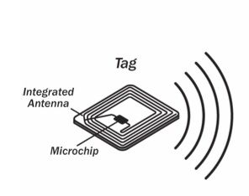
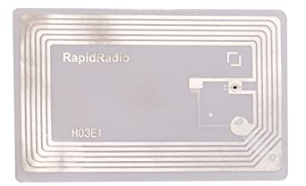
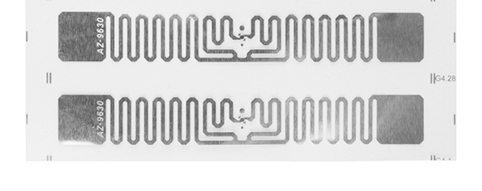
Radio Frequency ID
Cheap, low-power ubiquitous communication
RFID tags on (or in) products
NFC communication to/from smartphone
Requirements
Need to transmit small amount of data (ID)
Need to operate with little or no energy
Most do not have batteries
Short interaction time (fast enough bit rate)
Range can be extremely limited
Meters to centimeters (or millimeters)

Slide 25
Making ultra-low power radios
How do we make a radio that’s lower power?
What is the most costly part of the radio?
Carrier-frequency generation
Modulating bits is comparatively lower energy
Solution: do not generate carrier
Instead, use existing RF signal transmitted nearby
Common case: sent from nearby higher capability device
Dream case: use ambient RF signals to communicate
Bonus: can harvest energy from the signal being sent
Two versions in practice: backscatter and inductive coupling

Slide 26
Backscatter theory of operation
Vary between absorbing or reflecting signal to modulate data
Wireless transmissions at mircowatts of power draw
Frequency bands: 400 MHz, 900 MHz, 2.4 GHz
These are the really really cheap tags (~$0.15 each)
Ambient RF signal
Antenna
Reflected (backscatter) signal
RF Switch
Modulating Signal (Digital)
Backscatter tag
Reader/ Receiver

Slide 27
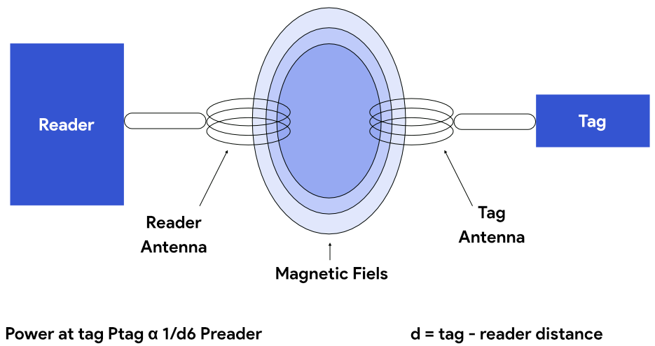
Inductive coupling theory of operation
A shared magnetic field is created between the two devices
Change in current through one device induces current change through the other
Device can vary load to transmit data
Very low frequency bands (135 KHz, 13.56 MHz)
Transmit through materials including skin
Sensitive to metal

Slide 28
RFID challenges
Essentially free communication!
What’s the cost (besides having a higher-capability device)
Difficult to reflect energy when it is already so low
Essentially double the path loss (there and back)
Range is very limited (or transmit power needs to be high)
Meters of range, maximum
Centimeters for inductive coupling
Alternatively, could decouple signal generation from reception

Slide 29
Classes of RFID devices
Passive RFID
No battery, harvests energy from RF signals
Active RFID
Contains a battery used to operate
Still reflects RF signal to communicate
Enables long battery lifetime

Slide 30
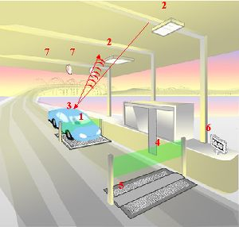
Car RFID systems
Two mounted antennas
One broadcasts energy, activating the RFID device
The other receives the reflected data
Devices are battery powered for longer-range operation
Don’t have to energize themselves with signal
Batteries last a decade

Slide 31
MAC layer for RFID tags
Cards are limited in capability so we can’t do anything fancy
But tags are frequently co-located, so some solution is necessary
Option 1: Aloha with pseudo-random backoff
Reader sends out initialization, tags randomly respond back
Option 2: Adaptive binary tree
Reader sends out initialization, along with first bit of ID
All cards matching that ID respond
Reader sends out a second bit of ID
Repeat until CRC is valid, then go back and choose other branches

Slide 32
What data should a card send?
Let’s think about security for a minute
Is just sending ID bits sufficient?

Slide 33
What data should a card send?
Let’s think about security for a minute
Is just sending ID bits sufficient?
Simple identification, maybe. (e.g. products in a store)
For authentication, no. Need to avoid replay attacks.
Include some kind of challenge and response
Probably also encrypted
May also read/write from an arbitrary memory in the card
Up to several hundred bits of storage

Slide 34
Electronic Product Code (EPC)
Format created by GS1
Not-for-profit org that created and standardized barcodes
12-byte identifier for products for RFID use
Header | EPC Manager | Object Class | Serial Number
8 bits | 28 bits | 24 bits | 36 bits
(version number) | (Company ID) | (Product type SKU) | (Unique per instance of product)

Slide 35
Near Field Communication (NFC)
Same Inductive Coupling concept (13.56 MHz)
But attached to a powered and capable device (smartphone)
Can act as a tag or as a reader
Allows smartphone to power a tag if needed
Alternatively, smartphone could act like a card and respond to a reader
Two smartphones can communicate without power transfer
Data rate 100-400 kbps!
nRF52840 capable of 100 kbps communication with attached antenna

Slide 36
Outline
LPWAN Challenges
Bit flux
Capacity problems
Coexistence problems
RFID Overview
Backscatter for Sensors

Slide 37
“Embedded” sensors
How do you change batteries in a device that’s inside a wall or inside someone’s body?

Slide 38
Backscatter for sensor networks
Conventional
Radio
Backscatter
Transmissions
Backscatter Tag
Backscatter allows transmissions at up to 10000x lower power than conventional radios
Makes it very attractive for low-energy sensing devices

Slide 39
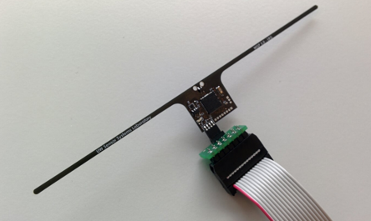
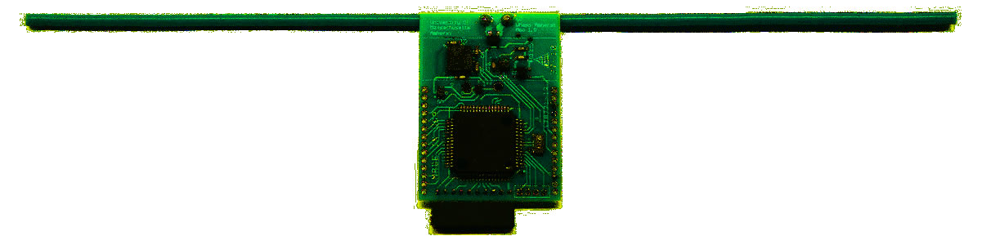
RFID sensors
First iterations were literally RFID sensors
Limited by cost and range of RFID readers (only a few meters)
Moo 1.0
University of Massachusetts
WISP 5.0
University of Washington

Slide 40
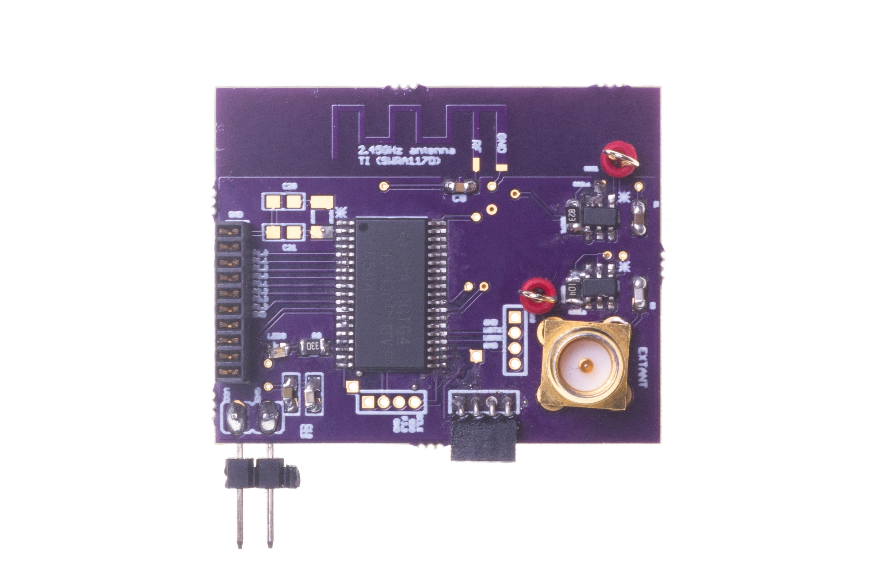
Backscatter + LPWAN = usable?
Idea:
Backscatter is about low energy operation
LPWANs are about long-range operation
Can we combine them for low energy and medium-long range?
LoRea: long-range transmissions at μW
(Next few slides stolen from Ambuj’s talks)
Varshney et al. ”LoRea: A Backscatter architecture that achieves a long communication range” SenSys 2017

Slide 41
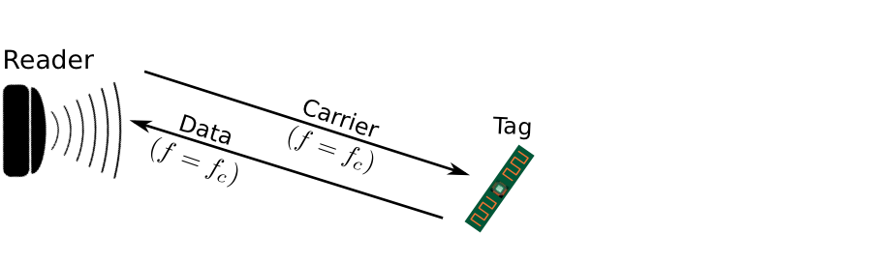
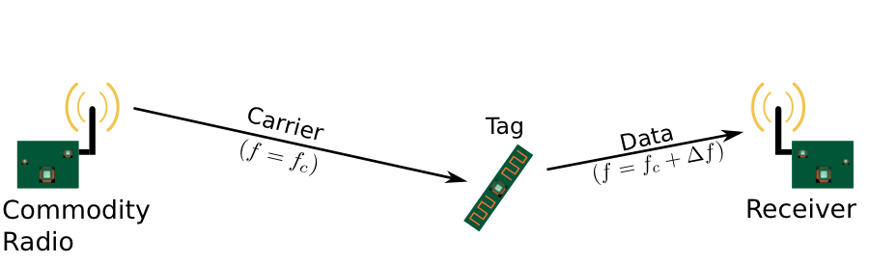
Design element #1: LoRea decouples the carrier signal generation and reception
Bi-static setup spatially separates carrier generation from the receiver
Use devices that surround us for providing the necessary carrier signal
Self-interference reduced due to path loss suffered by carrier signal
Monostatic configuration
Bi-static configuration
Notes:
+ If we look into a RFID reader's configuration, there is a single device that both receives the backscatter transmissions and generates the necessary carrier signal. This is called a monostatic configuration.
+ In LoRea, we decouple the task of carrier signal generation and the reception of the backscatter transmissions. We adopt a bistatic configuration as we show in the slide. We have a dedicated device for carrier signal generation and reception.
+The advantage of the bistatic configuration is two-fold: First, we can attenuate the carrier signal arriving at the receiver due to the path loss suffered due to the propagation of the wireless signal. This helps us reduce interference from stronger carrier signal to much weaker backscatter transmission. Second, it also enables us to use the devices that surround us, such as smartphones or wifi router, as sources for providing the necessary carrier signal to support backscatter transmissions. In fact, in lorea, we demonstrate the use of these devices to provide the carrier signal.’

Slide 42
Design element #2: LoRea backscatters at a frequency offset from the carrier signal
Backscatter is a mixing process
Transceivers attenuate interference at adjacent frequency channels
Frequency separation reduces interference from carrier to backscatter signal
No complex self-interference mechanisms required at reader
Notes:
+ The second design element that we incorporate in the design of LoRea is that we create separation in frequency between the carrier signal and the reflected transmissions. We transmit the backscattered signal at a particular offset from the carrier signal. This is unlike systems such as RFIDs that transmit at the same frequency as the carrier signal, requiring complex and expensive self-interference cancellation mechanisms.
+ To backscatter at an offset from the carrier signal, we take advantage of the property that the backscatter is a mixing process. If a carrier signal is incident on the backscatter tag, and if we toggle the antenna, i.e., change the antenna's state between absorption and reflection state at a frequency delta f, we can now create backscatter transmissions at a frequency offset of Fc+delta F due to the mixing property.
+ Most modern radio transceivers have bandpass filters present in adjacent frequency bands. They support these to enable co-existence on the shared wireless spectrum to suppress interference from adjacent traffic. We use these filters to our advantage; we place the carrier signal in the bandpass filter and significantly attenuate the carrier signal.
+ By incorporating the decoupling in space and frequency, we can reduce the interference to the weak backscatter transmissions from stronger carrier signal by up to 50-70 dB. We do not need to employ any complex self-interference cancellation mechanisms that are used on existing RFID readers. We use off-the-shelf commodity transceivers that just cost a few usd to carrier generation and the reception, thus significantly lowering the infrastructure's cost and complexity to support backscatter transmissions.

Slide 43
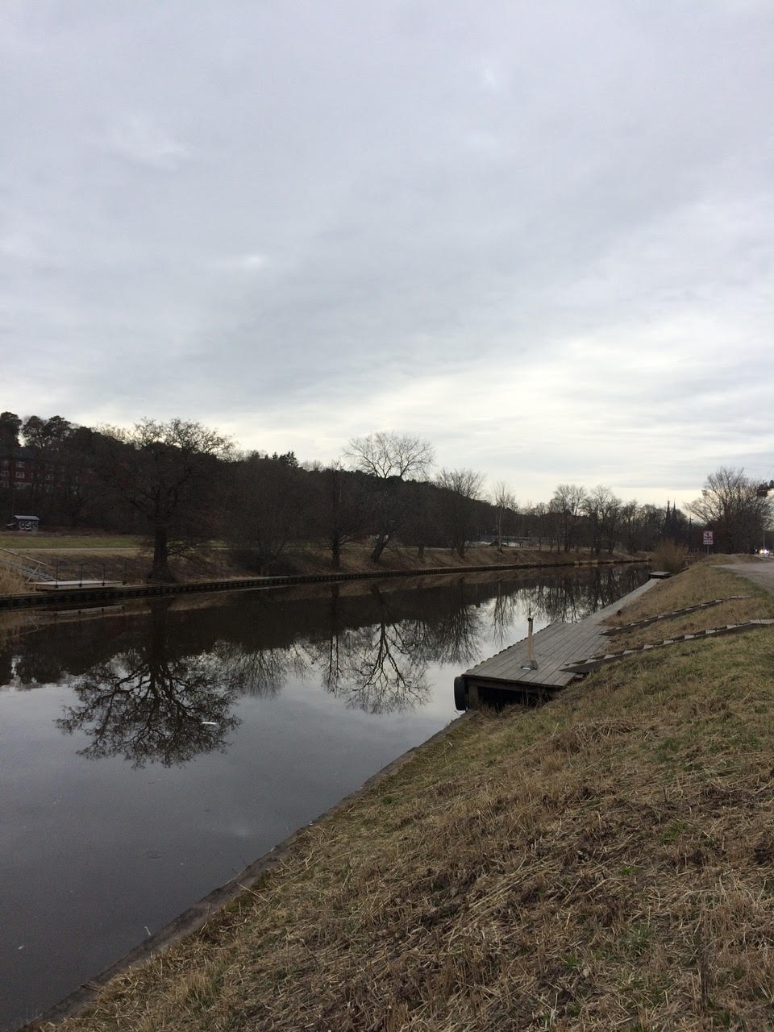
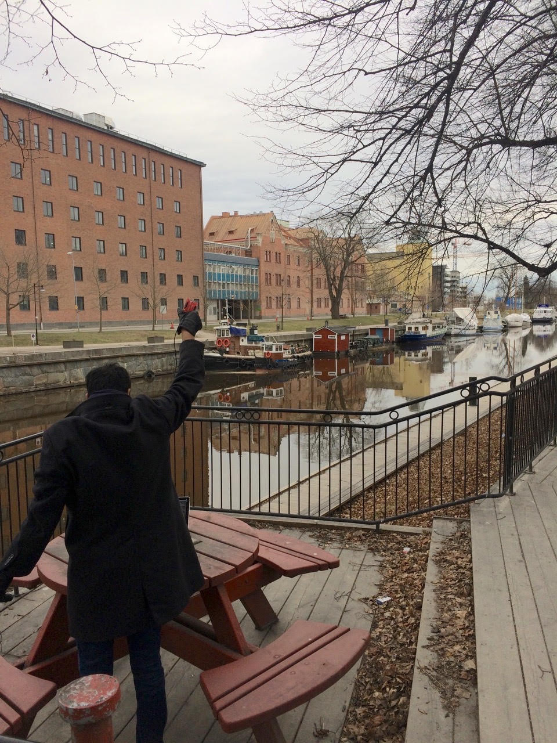
We ran out of space while performing experiments
State-of-art few meters. We achieved kilometers, was difficult to anticipate
Initial experiments conducted near the university and a river in Uppsala
Experiment Setup
Receiving transmissions 1km away from the setup

Slide 44
LoRea outperforms state-of-the-art systems
System name | Communication range
LoRea – 868 MHz (SENSYS 2017) | 3400 m
LoRea – 2.4 GHz (SENSYS 2017) | 225 m
RFID | < 18 m
BackFi (SIGCOMM 2015) | 5 m
Passive WiFi (NSDI 2016) | 30 m
HitchHike (SENSYS 2016) | 54 m
Interscatter (SIGCOMM 2016) | 30 m
LoRa Backscatter (UBICOMP 2017) | 2800 m
Range reported are line of sight, with backscatter tag co-located with carrier source

Slide 45
Future research directions for Backscatter
Improve capabilities for “ambient” backscatter
Reuse existing RF signals rather than relying on carrier generation
MAC layers for backscatter
Need ability to communicate with very low power
How do you manage access to the medium?
Real-world usable backscatter stacks and hardware
Needs to be deployable and usable by non-experts

Slide 46
Outline
LPWAN Challenges
Bit flux
Capacity problems
Coexistence problems
RFID Overview
Backscatter for Sensors

